Slide 1


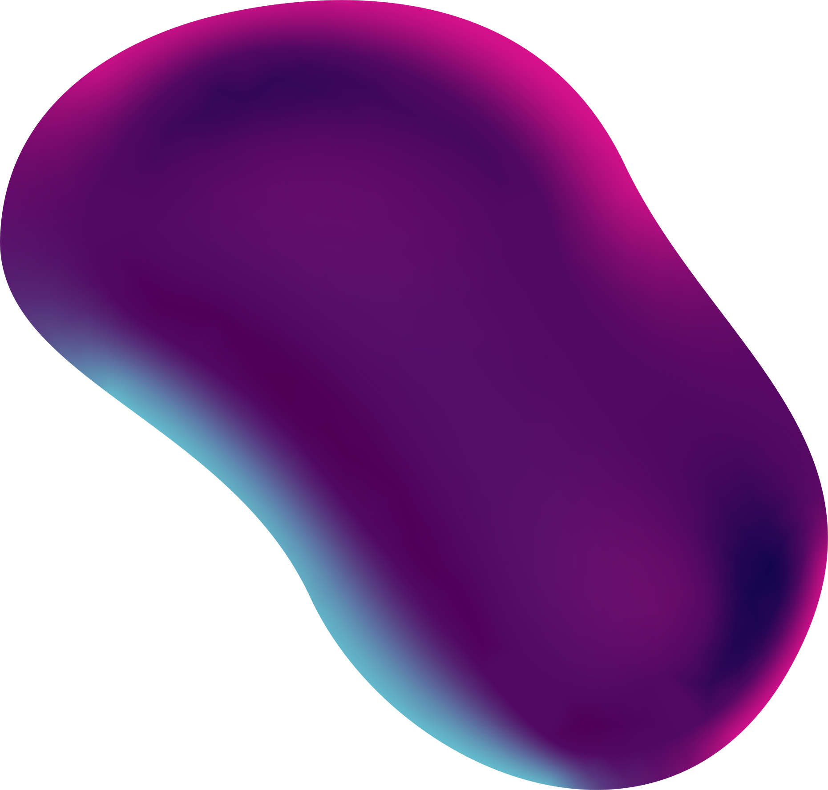
Brain Tumor MRI
Classification
Alan Pawleta, Nikodem Wspaniały

Slide 2
Used technology
Python 3
Tensorflow
Keras
a high-level, interpreted programming language known for its readability and versatility. It supports multiple programming paradigms, including procedural, object-oriented, and machine learning.
An open-source machine learning framework developed by Google. It is designed to make it easy to build and deploy machine learning models.
A high-level neural networks API, written in Python and capable of running on top of TensorFlow, Microsoft Cognitive Toolkit, or Theano.

Slide 3
https://www.kaggle.com/datasets/masoudnickparvar/brain-tumor-mri-dataset/data
Data divided into test and training folders
Training folder contains 5712 images of brain tumors that are used to train the model.
Test folder contains 1311 images of brain tumors that are used to test the model.
3 types of brain tumor to classify: glioma, meningioma and pituitary
Images sizes: 512x512 px
Dataset

Slide 4
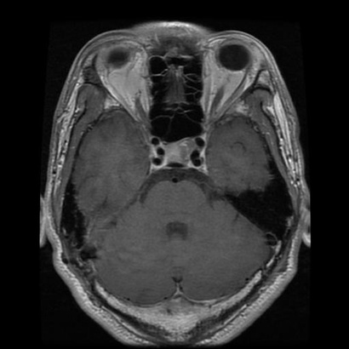
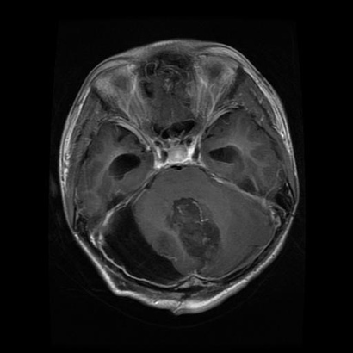
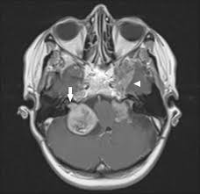
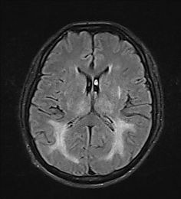
Sample photos of a given type
Pituitary
Glioma
Meningioma
No tumor

Slide 5
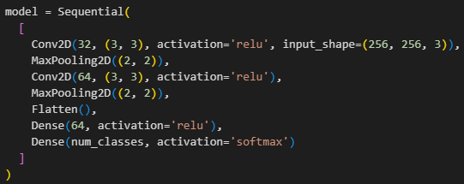
CNN Model - first try

Slide 6
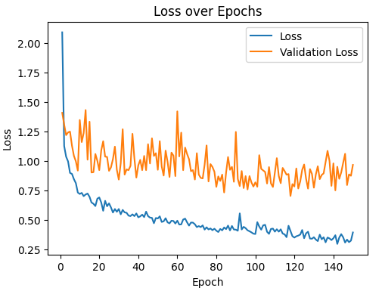
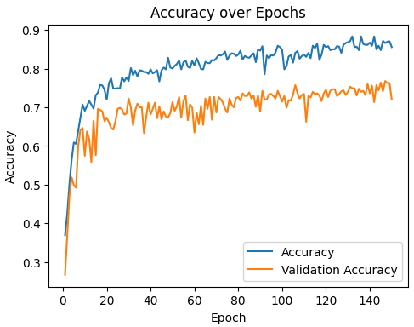
Loss and accuracy over Epchos

Slide 7
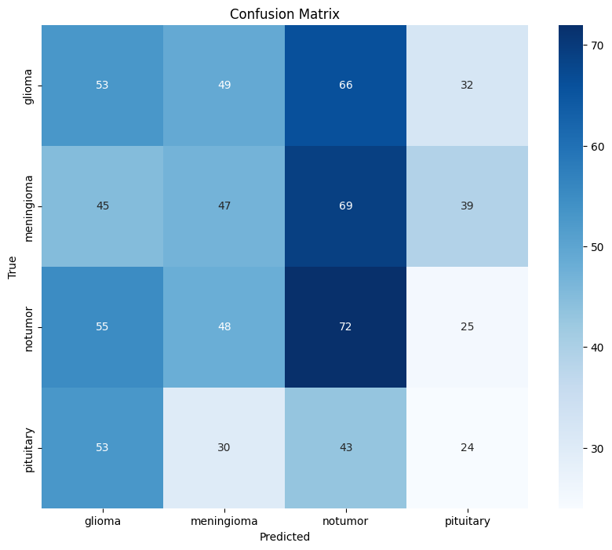
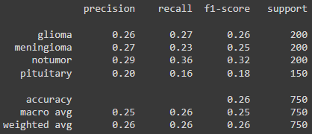


Results
Validation Loss: 0.97
Validation Accuracy: 0.72

Slide 8
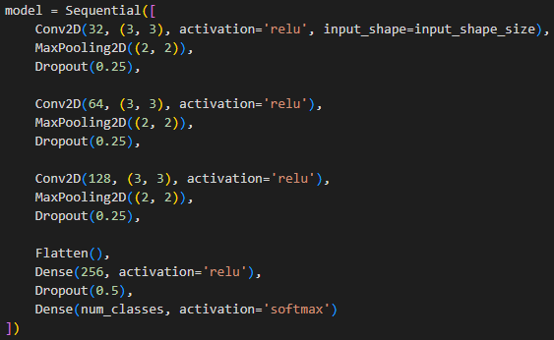
CNN Model - first try

Slide 9
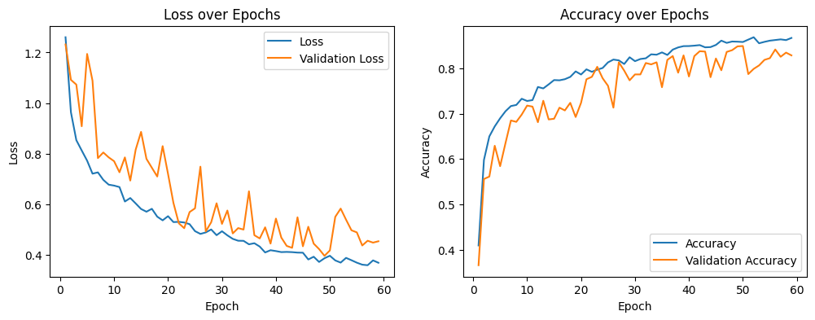
Loss and accuracy over Epchos

Slide 10
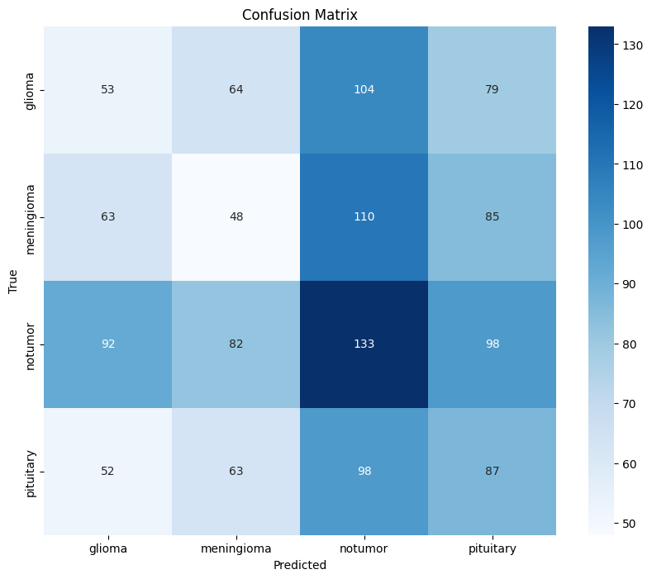
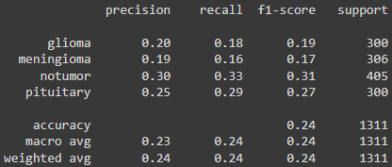
Results
Validation Loss: 0.39 Validation Accuracy: 0.84

Slide 11


Work in progress...
„It always seems impossible until
it’s done.”
— Nelson Mandela

Slide 12
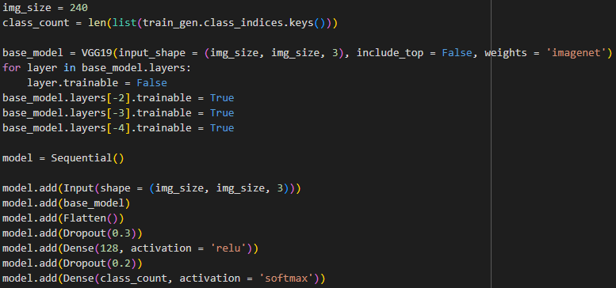
VGG 19 Model - change of approach

Slide 13
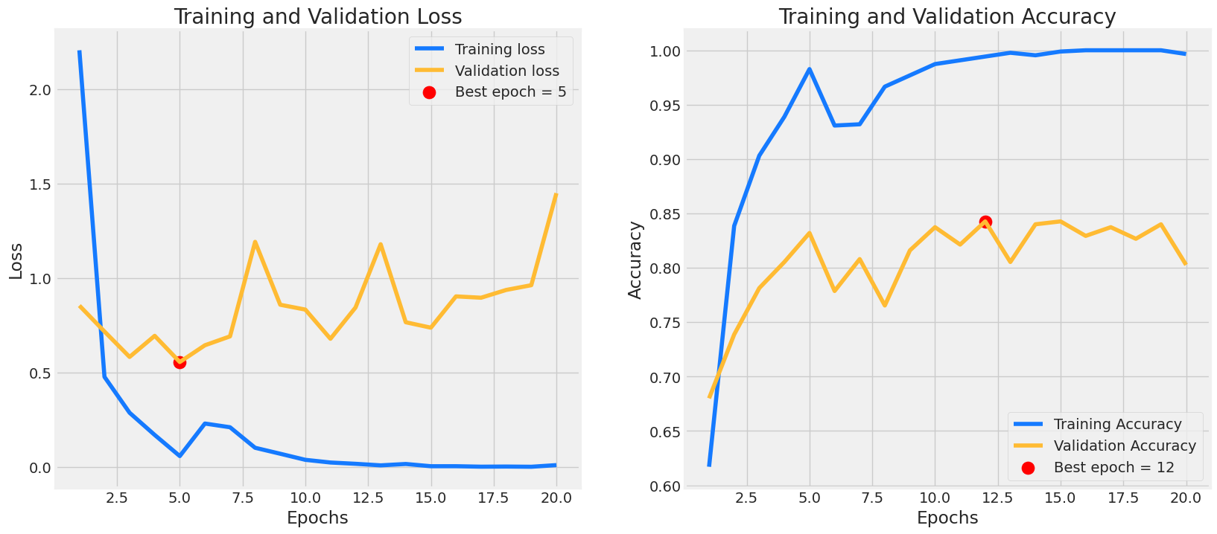
Loss and accuracy over Epchos

Slide 14
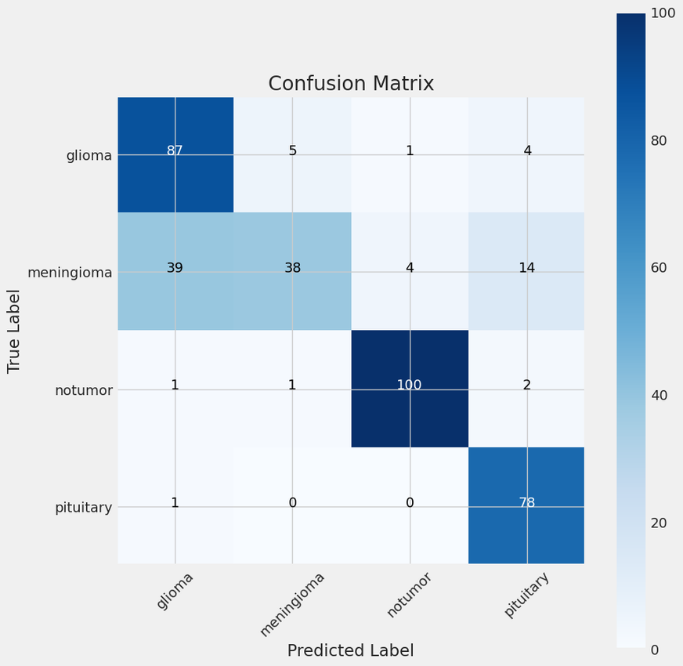
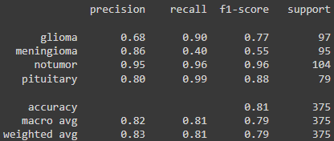

Results
Train Loss: 0.0034 Train Accuracy: 0.99
Validation Loss: 1.44 Validation Accuracy: 0.80

Slide 15

Final models
COMPARISON OF
3 CNN NEURAL NETWORK MODELS

Slide 16
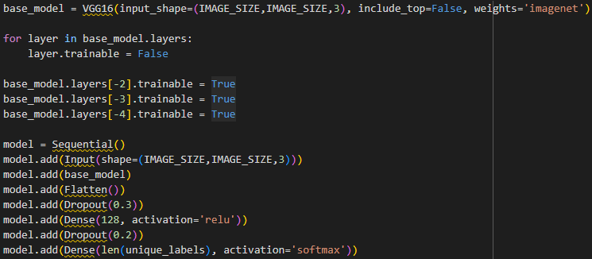
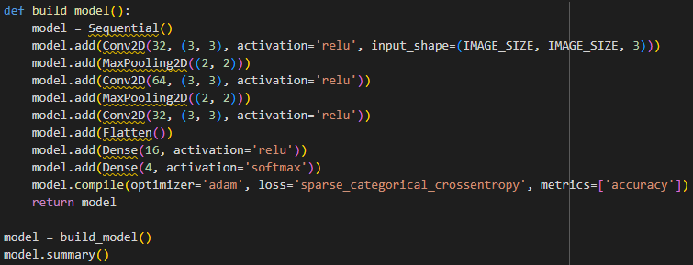
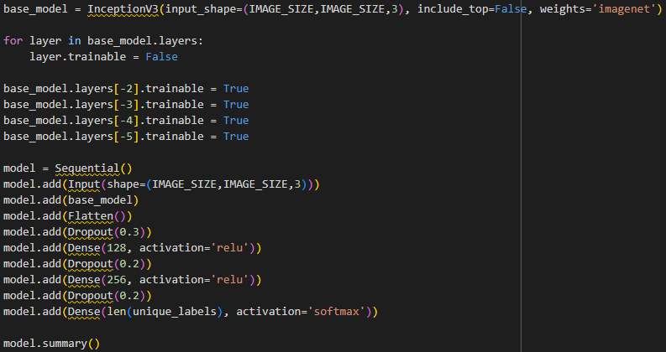
Three CNN Models

Slide 17
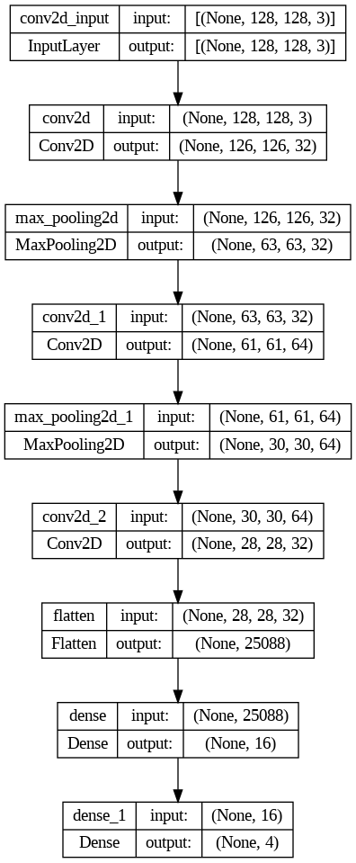
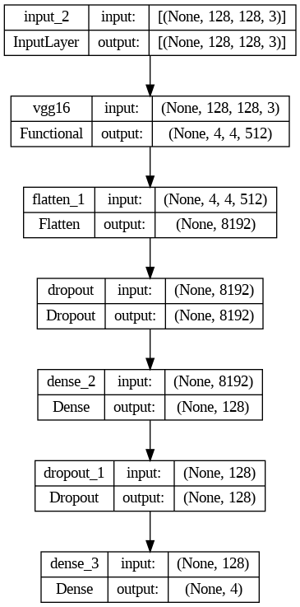
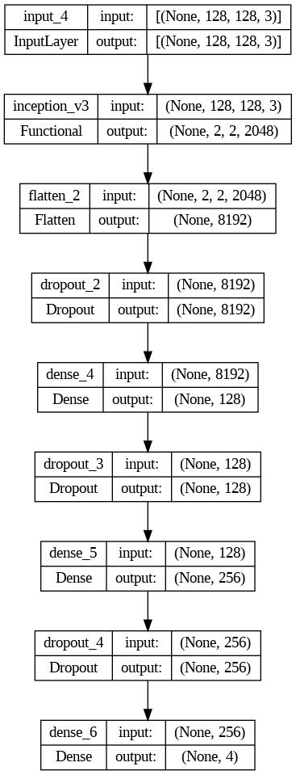
Plot models

Slide 18
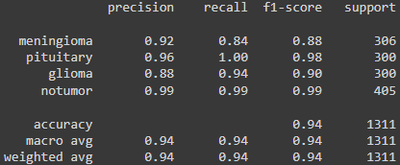
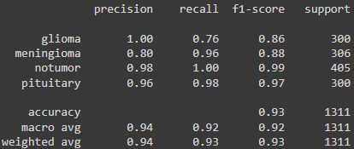
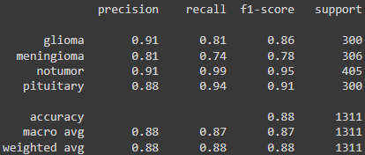
Results

Slide 19
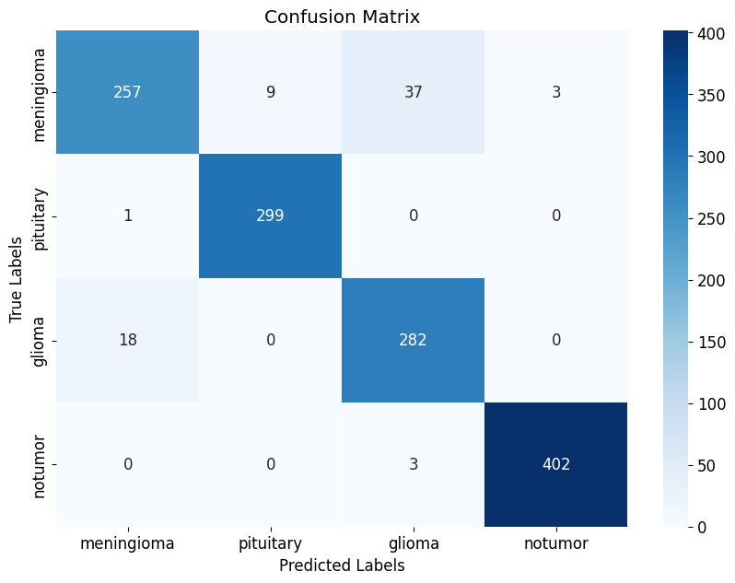

Confusion Matrix - first CNN Model

Slide 20
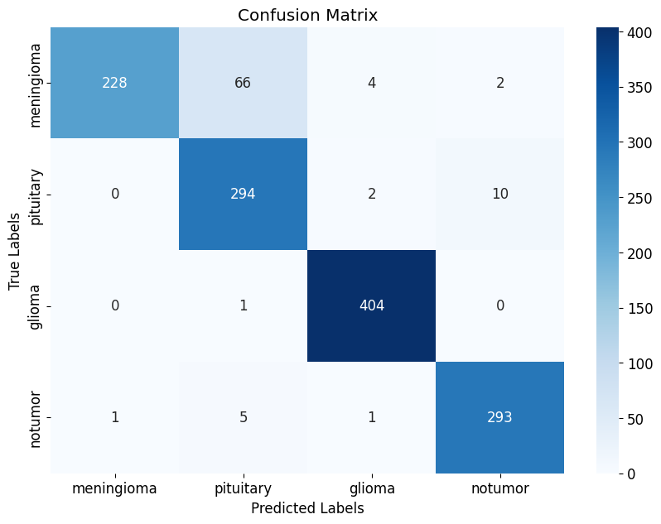

Confusion Matrix - second CNN Model

Slide 21
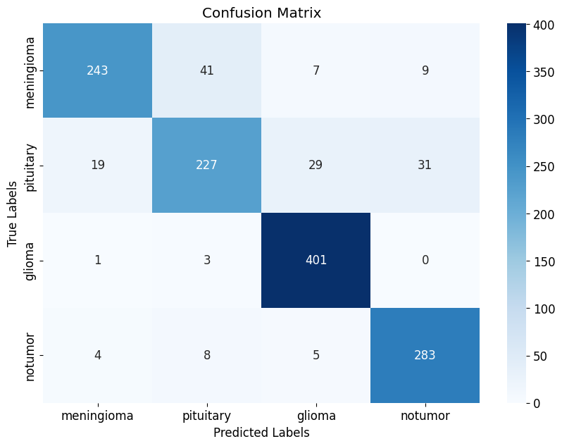



Confusion Matrix - third CNN Model

Slide 22

Conclusion
Model 1 achieves the highest overall accuracy (0.94) and balanced performance across all metrics.
Model 2 has slightly lower accuracy (0.93) but the highest precision for the "glioma" class. However, this model has a lower recall for this class, which means it may miss many cases of "glioma".
Model 3 achieves the lowest accuracy (0.88) and has lower metric values ​​compared to other models, indicating that it is the least effective.

Slide 23

THANK YOU FOR YOUR ATTENTION

